Slide 1
CS 4/57207- Digital Forensics
Chapter 5 – Windows System Artifacts

Slide 2
Deleted Data
“Deleting” a file means that the space occupied by the file is available if the computer needs it.
Deleted data remains on the drive until a file is written over it
This normally takes a long time to do if it happens at all.

Slide 3
File Carving
File Carving – extracting data from unallocated space
Can be done manually or with a tool
Files are identified in unallocated space by unique identifiers such as:
File Header
File Signature
Footers
Unallocated space may have valuable evidence

Slide 4
Sleep
Hiberfile.sys
Deep sleep modes save data to hard drive
“Sleep” saves data to RAM
Hybrid mode is a mixture of the two
Keeps minimum power to write to RAM but also writes to hard disk

Slide 5
Registry
Critical
Many of the artifacts we need are in the registry
Abundant in evidence
Search terms, program installations, web addresses, etc…
Computers Central Nervous System

Slide 6
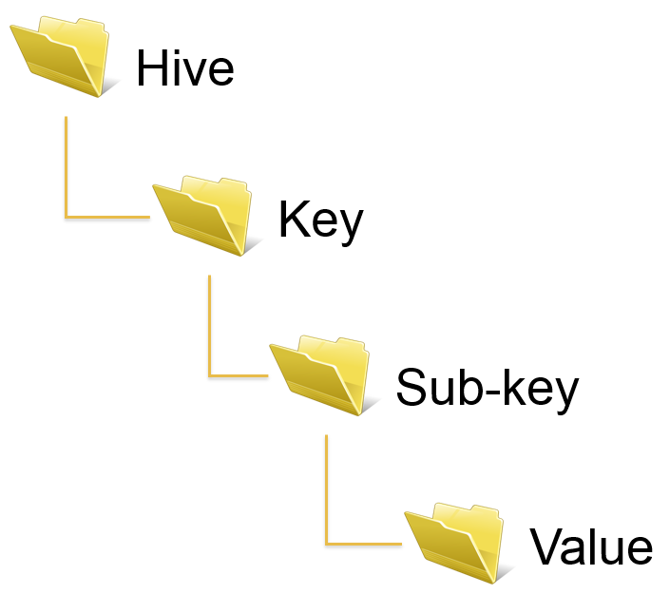
Registry Structure

Slide 7
Attribution
Who did it?
Connect the right dots to put the right person behind the keyboard
A PC may have multiple user accounts
Difficult to determine “who” was on the computer when an artifact may have been created

Slide 8
Print Spooling
Printing activities can leave tracks to follow
Spooling is the delay that happens after you click print
Enhanced Meta File (EMF) – Image of document to be printed
Spool File (.spl) – Information about the print job
These files can directly connect targets to their crime

Slide 9
Recycle Bin Function
Will not erase evidence
Moves files to unallocated space
Recycle Bin Bypass
Moves straight to unallocated space

Slide 10
Metadata
Data about Data
Like information about a JPG file (size, date, resolution, etc.)

Slide 11
Date and Time Stamps
System date and time states can be easily changed
Time Zones can be spoofed
Removing Metadata
Tools can be used to delete metadata
Recovered metadata can refute claims of a suspect having no knowledge of a file

Slide 12
Thumbnail Cache
thumbs.db + thumbcache.db
Remain after images have been detected
Most Recently Used
MRU
Files and applications that have been recently used

Slide 13
Restore Points
Can tell us when data existed
Can reveal evidence that doesn’t exist anywhere else
Shadow Copies
Provide source data for restore points
Show how a file has been changed over time
Copies of deleted files

Slide 14
Prefetch
Show that an application was installed and ran
The presence of certain applications can be incriminating
Link Files
Shortcuts to other files
Contain file paths
Show a file was opened

